Slide 1
Loan Default Prediction Manor Resources
Xuan Yin
xyin3@uic.edu
March 10, 2017

Slide 2
Xuan Yin
Ph.D. candidate in Economics
M.S. in Statistics
The University of Illinois at Chicago
Specialty: Econometric Modeling, Statistical Analysis, Data Mining, Machine Learning
xyin3@uic.edu
https://www.linkedin.com/in/xuanyin/

Slide 3
Introduction
The main objective is to utilize machine learning algorithms to predict loan default.
Data Clean (12 steps)
Learning Algorithms (6 models)
Performance Measure
Problem: Imbalanced Classes
Performance Comparison
Conclusion

Slide 4
Data Clean
Step 1: Reconstruct Outcome Variable: loan_status
Non-default | Default
“Current” “Fully Paid” “In Grace Period” “Does not meet the credit policy. Status:Fully Paid” | “Charged Off” “Default” “Late (16-30 days)” “Late (31-120 days)” “Does not meet the credit policy. Status:Charged Off”
All “Issued” observations were deleted.

Slide 5
Data Clean
Step 2: Removing variables containing more than 50% missing values
Variables | Proportion of Missing Values (%)
dti_joint | 99.94936962
annual_inc_joint | 99.94914207
il_util | 98.67063973
mths_since_rcnt_il | 98.51908993
open_acc_6m | 98.47881318
open_il_6m | 98.47881318
open_il_12m | 98.47881318
open_il_24m | 98.47881318
total_bal_il | 98.47881318
open_rv_12m | 98.47881318
open_rv_24m | 98.47881318
max_bal_bc | 98.47881318
all_util | 98.47881318
inq_fi | 98.47881318
total_cu_tl | 98.47881318
inq_last_12m | 98.47881318
mths_since_last_record | 84.58822713
mths_since_last_major_derog | 75.06277598
mths_since_last_delinq | 51.232935

Slide 6
Data Clean
Step 3: Removing observations of missing values
Variables | Proportion of Missing Values (%)
tot_coll_amt | 7.995731
tot_cur_bal | 7.995731
total_rev_hi_lim | 7.995731
revol_util | 0.056774
collections_12_mths_ex_med | 0.016498
delinq_2yrs | 0.0033
inq_last_6mths | 0.0033
open_acc | 0.0033
pub_rec | 0.0033
total_acc | 0.0033
acc_now_delinq | 0.0033
annual_inc | 0.000455

Slide 7
Data Clean
Step 4: Trim outliers for numerical variables
Outliers Definition
< Q1 – 6 * IQR or > Q3 + 6 * IQR
Q1: 1st Quartile, Q3: 3rd Quartile, IQR: Inter-Quartile Range
For each numerical variable, identify outliers
Drop observations containing outliers
Step 5: Drop numerical variables of zero variance
Step 6: Detect and drop numerical variables of collinearity
Step 7: Rescale all numerical variables between 0 and 1 (or standardization)
Step 8: Drop numerical variables that were not so correlated with the outcome
Regress each numerical variable on outcome
As long as the F-statistic is not significant at 95% level, drop the numerical variable
Notes:
Step 4, SVM is robust to outliers
Step 6, some models are robust to collinearity: ridge, LASSO
Step 7, different scale of indicators have negative effect on most learning algorithms
Step 8, it may drop indicators that have nonlinear associations with the outcome

Slide 8
Data Clean
Step 10: Clean factor variables that have too many levels
string variables (text variables) were treated as factor variable
“desc” was convert to numerical variable as the length of “desc”
“addr_state” was replaced by the numerical variable “state median household income in 2015” from Census Bureau
Factor Variables Deleted | Levels
sub_grade | 35
issue_d | 103
title | 63146
earliest_cr_line | 698
next_pymnt_d | 101
emp_title | 299273
url | 887379
zip_code | 935
last_pymnt_d | 99
last_credit_pull_d | 104

Slide 9
Data Clean
Step 10: Clean factor variables that have too many levels
Step 11: Drop factor variables of unit sparsity
e.g., 2 levels, 1, 1, 1, 1, …, 1, 1, 1, 0. 99.99% of values are 1
Step 12: Create design matrix: expand factor variables into dummies
Classification trees are Ok with factor variables
Regression models accept dummies rather than factor variables

Slide 10
Learning Algorithms
Logistic Regression
Nice interpretation (odds, odds ratio)
Computation is fast
Logistic Regression with Ridge
Deal with collinearity, variable selection
L2 penalization, computation is fast
Logistic Regression with LASSO
Deal with collinearity, variable selection
L1 penalization, computation is slower than the first two
Gradient Boosting (base learner is Logistic Regression)
A synthesis of prediction accuracy, nonlinear/nonparametric functional forms, and variables selection
High computation cost
Random Forest
Non-parametric, top-notch performance
High computation cost
Support Vector Machine (SVM)
top-notch performance, high computation cost
Notes:
Gradient Boosting: Base model is logistic regression. Each continuous feature --> logistic with penalized spline. All discrete features --> logistic with ridge regression. Gradient descend to minimize the negative binomial likelihood. In each step, the gradient of the model that minimizes the objective among all models in that step is chosen. Optimal stop to avoid overfitting: 5-fold Cross Validation. Disadvantage: High Computational Cost

Slide 11
Performance Measure
For each model, do 10-fold cross validation
For each model and each time of cross validation, obtained confusion matrix, calculate statistics based on confusion matrix
For each model, calculate average statistics (average over 10)
 | Default | Non-default
Precision | When it predicts default, how often is it correct? | When it predicts non-default, how often is it correct?
Recall | When it's actually default, how often does it predict default? | When it's actually non-default, how often does it predict non-default?
F-score | Weighted average of precision and recall | Weighted average of precision and recall
Accuracy | Overall Measure of Prediction Accuracy
Notes:
Default Recall: it matters whether we suffer the risk. A person won’t pay back the money, but we lend money to him, because the model predict he won’t be default.
Non-default Recall: it matters whether we lose business. A person will pay back the money, but we don’t lend money to him, because the model predict he will be default. We loose the opportunity to make money, to make business with him.

Slide 12
Problem: Imbalanced Classes
Default | Non-default
6,548 | 314,464
2.04% | 97.96%
Whoever comes, logistic can never predict him/her as default!!!
Logistic with Imbalanced Classes | Default | Non-default
Precision | NA | 0.980
Recall | 0 | 1
F-score | NA | 0.990
Accuracy | 0.980
Notes:
Logistic never predict it as default

Slide 13
Problem: Imbalanced Classes
Method 1: Raise the bar
Usually, when the predicted probability is greater than 0.5, we classify the person as non-default. We can adjust the cutoff point so that only when it is greater than 0.8, we classify the person as non-default.
Method 2: Oversample observations from underrepresented class, and/or, undersample observations from overrepresented class, then train the model.
Here I use the second method. But in my project of lending club, I use the first method.
Default | Non-default
150,261 | 149,739
50.09% | 49.91%
I randomly sampled the data to control the size as 100,000 because time limitation and computational time

Slide 14
Performance Comparison
Default Statistics
Notes:
Default Recall: it matters whether we suffer the risk. A person won’t pay back the money, but we lend money to him, because the model predict he won’t be default.
Non-default Recall: it matters whether we lose business. A person will pay back the money, but we don’t lend money to him, because the model predict he will be default. We loose the opportunity to make money, to make business with him.

Slide 15
Performance Comparison
Non-Default Statistics
Notes:
Default Recall: it matters whether we suffer the risk. A person won’t pay back the money, but we lend money to him, because the model predict he won’t be default.
Non-default Recall: it matters whether we lose business. A person will pay back the money, but we don’t lend money to him, because the model predict he will be default. We loose the opportunity to make money, to make business with him.

Slide 16
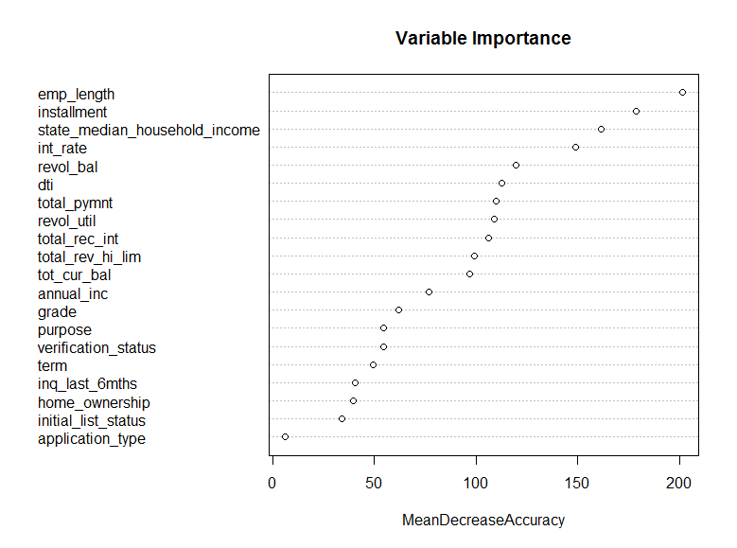
Feature Importance from Random Forest
Notes:
MeanDecreaseAccuracy means the total decrease in accuracy from splitting on the variable, averaged over all trees
Here we can check the relative importance of those features.

Slide 17
Conclusion
Random Forest outperforms all other models. However, the computational time is greater than logistic, ridge, and LASSO.
Because I take measure on collinearity and the association between indicators and outcome in data clean, the ridge and LASSO have no effect on logistic regression, and the gradient boosting, which is supposed to be good at nonlinearity, perfoms worse than logistic.
For large data, it will significantly save time to deal with collinearity and the association between indicators and outcome before modeling. And from this project, we can see it has no negative effect on Random Forest.
Support Vector Machine is supposed to have good performance, however, it has highly computational cost (12-hour, still no results).
More models could be explored in the future.

Slide 18
Inter-model Performance Comparison
Default | Logistic | Logistic with Ridge | Logistic with LASSO | Logistic Based Gradient Boosting | Random Forest
Precision | 0.650 | 0.650 | 0.650 | 0.308 | 0.993
Recall | 0.698 | 0.692 | 0.684 | 0.272 | 0.999
F-score | 0.673 | 0.671 | 0.667 | 0.289 | 0.996
Accuracy | 0.661 | 0.660 | 0.658 | 0.330 | 0.996
Non-Default | Logistic | Logistic with Ridge | Logistic with LASSO | Logistic Based Gradient Boosting | Random Forest
Precision | 0.674 | 0.671 | 0.666 | 0.347 | 0.999
Recall | 0.624 | 0.627 | 0.632 | 0.388 | 0.993
F-score | 0.648 | 0.648 | 0.649 | 0.366 | 0.996

Slide 19
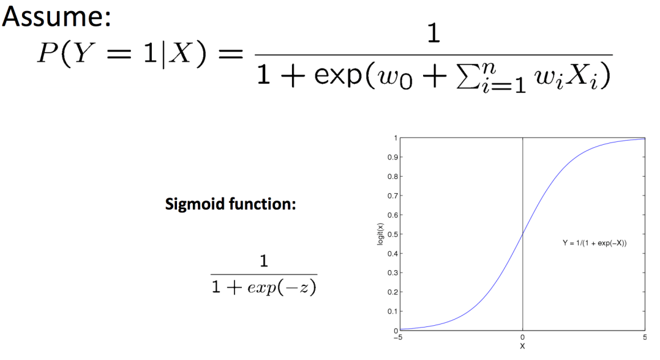
Logistic regression

